Slide 1
Agentic RAG Chatbot
Agentic RAG Chatbot: System Architecture*A multi-agent system for document-based Question Answering with a custom communication protocol
A Retrieval-Augmented Generation (RAG) chatbot that answers questions based on uploaded documents (PDF, PPTX, DOCX, CSV, TXT).
Core Design : Built on a multi-agent architecture where specialized agents collaborate to process, retrieve, and generate answers.

Slide 2
Project Overview & Key Features
Core Design: Built on a multi-agent architecture where specialized agents collaborate to process, retrieve, and generate answers.
Key Features:
📄 Multi-format document parsing.
🤖 Specialized agents for Ingestion, Retrieval, and Response Generation.
💬 Custom communication protocol (MCP) for structured agent interaction.
🔍 High-speed semantic search using FAISS and Sentence Transformers.
🗣 Support for multi-turn conversations and follow-up questions.
🖥 Clean, interactive UI built with Streamlit.

Slide 3
System Architecture: Code & Components
The system is organized into modular components, each with a specific responsibility.
agents/: The core logic units of the system.
ingestion_agent.py: Parses and chunks documents.
retrieval_agent.py: Creates embeddings and handles search.
llm_response_agent.py: Generates the final answer.
parsers/: Contains specialized functions to read different file types.
vector_store/: Manages the FAISS index for semantic search.
embeddings/: Handles the conversion of text to vectors.
mcp/: Implements the Model Context Protocol for agent communication.
ui/streamlit_app.py: The user-facing application.
main.py: The entry point that orchestrates the agents.

Slide 4
System Flow & Architectural Diagram
The system follows a clear, orchestrated flow from document upload to answer generation.
1. A user uploads a document, which the Ingestion Agent processes and stores in the FAISS Vector Store.
2. When a question is asked, the Retrieval Agent finds relevant context from the store.
3. The LLM ResponseAgent uses this context to get a precise answer from the Cohere LLM.
4. The final response is displayed to the user.

Slide 5
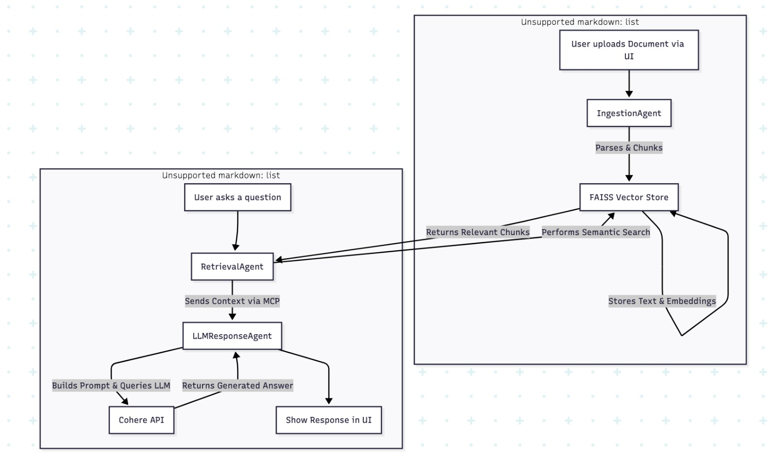
System Flow

Slide 6
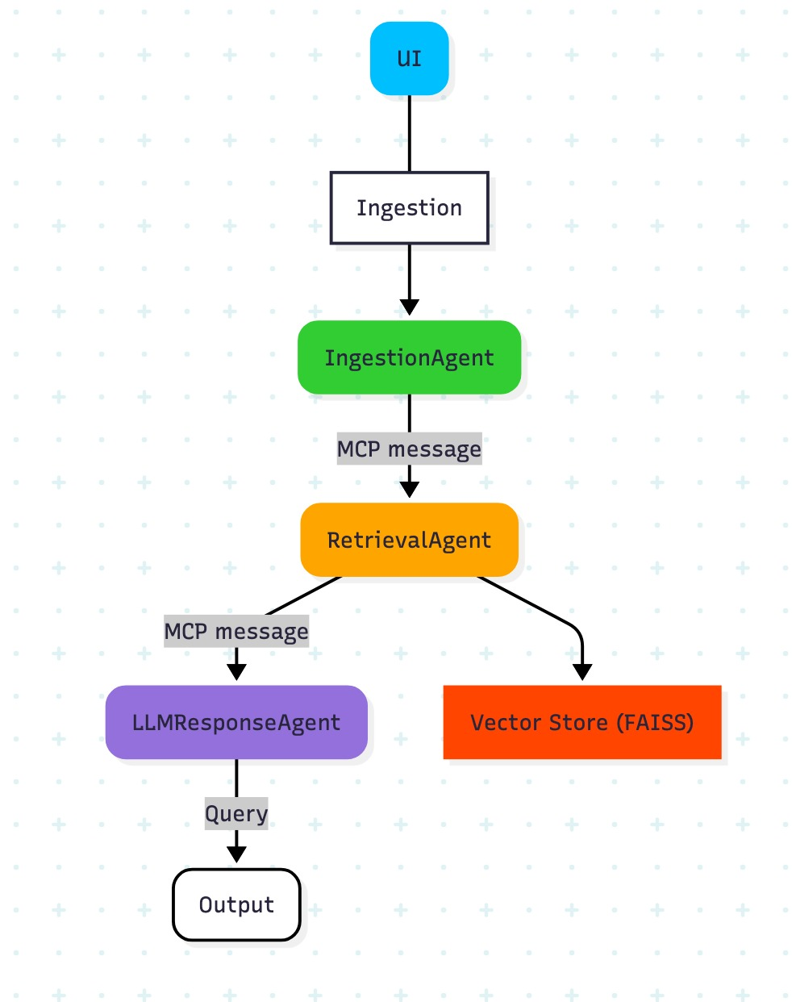
Architectural Diagram

Slide 7
The Model Context Protocol (MCP)
MCP is a custom JSON-based message format that enables structured communication and traceability between agents.
Modularity: Decouples agents, allowing them to be developed and tested independently.
Traceability: Each message has a trace_id, making it easy to debug the flow of a request.
Clarity: Provides a clear, explicit structure for data exchange.
Example MCP Message:
json { "sender": "RetrievalAgent",
"receiver": "LLMResponseAgent",
"type": "RETRIEVAL_RESULT",
"trace_id": "rag-457",
"payload": { "retrieved_context": ["context chunk 1", ...],
"query": "What KPIs were tracked in Q1?" } }

Slide 8
Technology Stack
The project is built on a modern, open-source Python stack.
Backend & Logic : Python 3.11+
User Interface: Streamlit
LLM: Cohere (command-r-plus)
Vector Search: FAISS (Facebook AI Similarity Search)
Embeddings: Sentence Transformers (all-MiniLM-L6-v2)
Document Parsing: PyMuPDF, python-pptx, python-docx, pandas

Slide 9
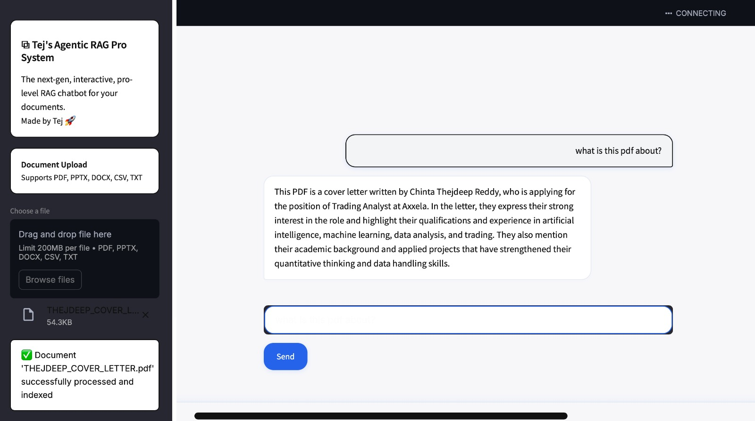
UI Screenshots of Working App

Slide 10
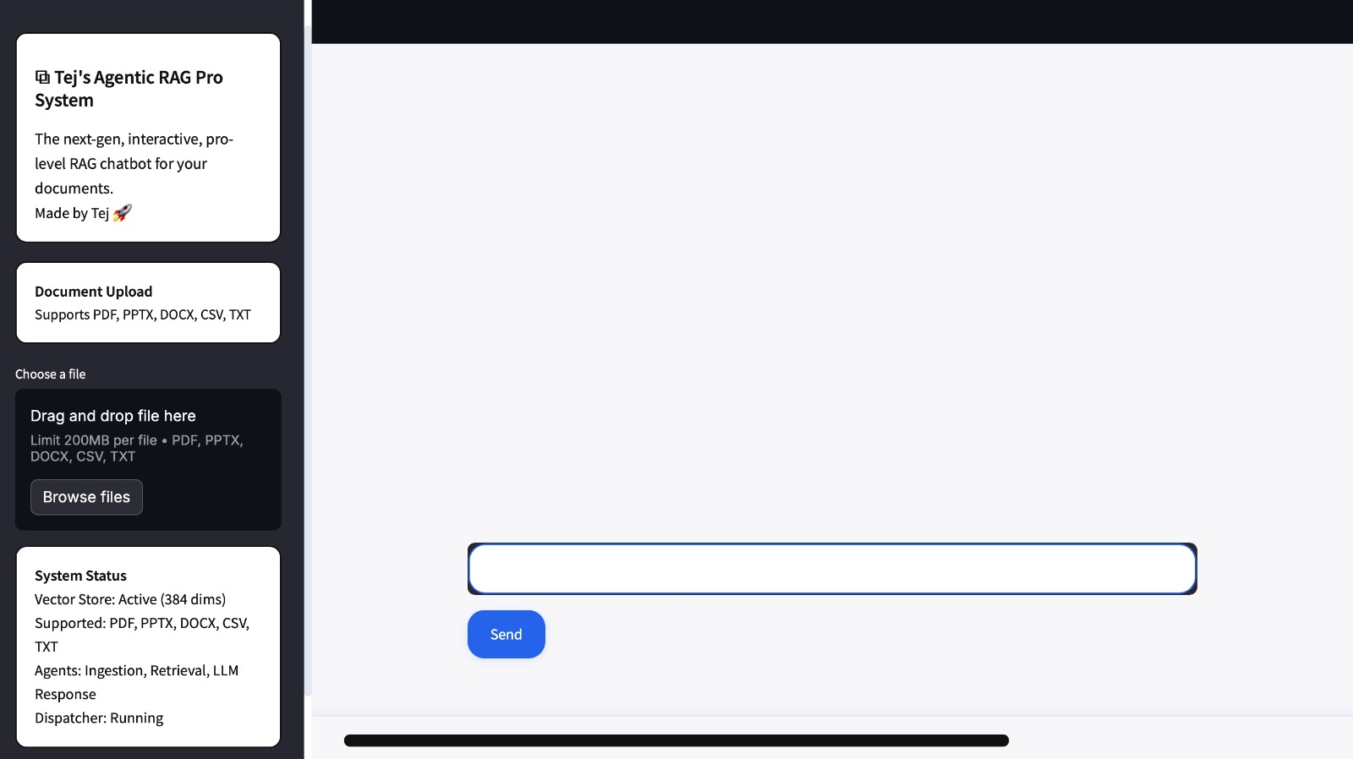
UI Screenshots of Working App

Slide 11
Challenges & Future Scope
Challenges Faced: Handling inconsistent parsing across document formats.
Ensuring a clear and robust MCP message flow.
Optimizing the embedding of large documents. Maintaining context in multi-turn conversations.
Future Roadmap: Deploy with FastAPI and Docker for production.
Integrate more LLMs (OpenAI, Mistral, Claude).
Use a message broker (Kafka/RabbitMQ) for asynchronous tasks.
Add user session management and chat history. Highlight source chunks in the UI for better explainability.

Slide 12
Conclusion
This agent-based architecture creates a robust, modular, and scalable RAG system. By separating concerns, it simplifies development and improves traceability.
Presented By:
Chintha Thejdeep Reddy
tejdeep2502@gmail.com

